Slide 1

A review of the quality of care in hospital provided to adults with abnormal levels of blood sodium
Key messages and recommendations

Slide 2
The study
Study population:
Patients aged 18 and over who were admitted to hospital between 1st October 2023 and 31st December 2023 and identified as having hyponatraemia or hypernatraemia during their admission.
Patients who presented as an emergency and those who developed abnormal blood sodium levels after surgery were included.
Data sources:
640 clinician questionnaires
498 hyponatraemia and 142 hypernatraemia cases
419 sets of case notes
156 organisational questionnaires

Slide 3
Data returns
49,511 adult patients were identified with an ICD 10 code* for hyponatraemia (42,410 patients) or hypernatraemia (7,101 patients) during the three-month study period
1,022 patients included
640 clinician questionnaires
419 sets of case notes
156 organisational
questionnaires
270 hyponatraemia - emergency admission
84 hyponatraemia -postoperative
65 hypernatraemia - emergency admission
106 - postoperative hyponatraemia
142 - hypernatraemia
392 hyponatraemia -emergency admissions

Slide 4
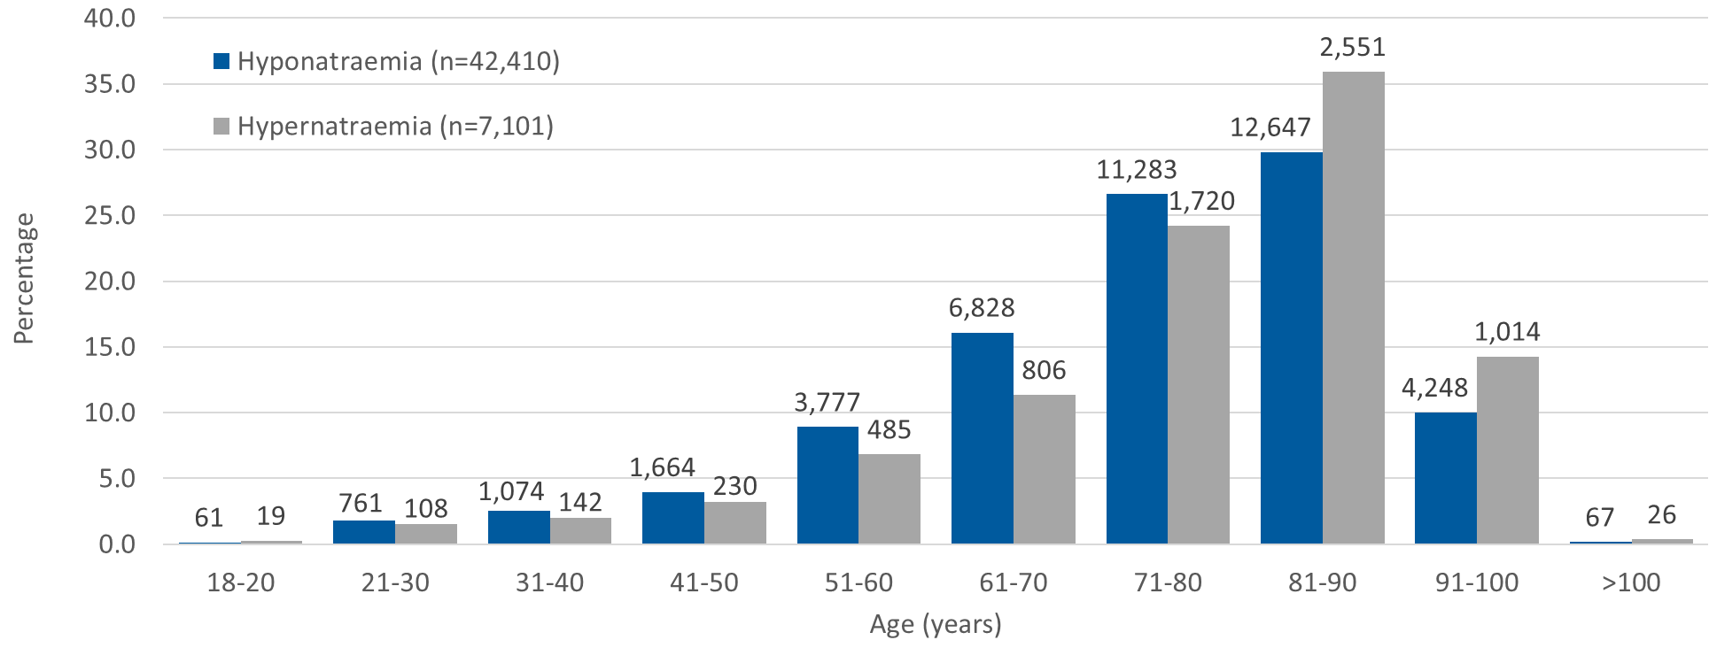
Age distribution of patients coded for hyponatraemia or hypernatraemia in the total study population
Notes:
In the whole study population, patients with a diagnosis code of hyponatraemia were slightly older (mean 74.0, median 77 years) than patients with a diagnosis code of hypernatraemia (mean 76.9, median 81 years)

Slide 5
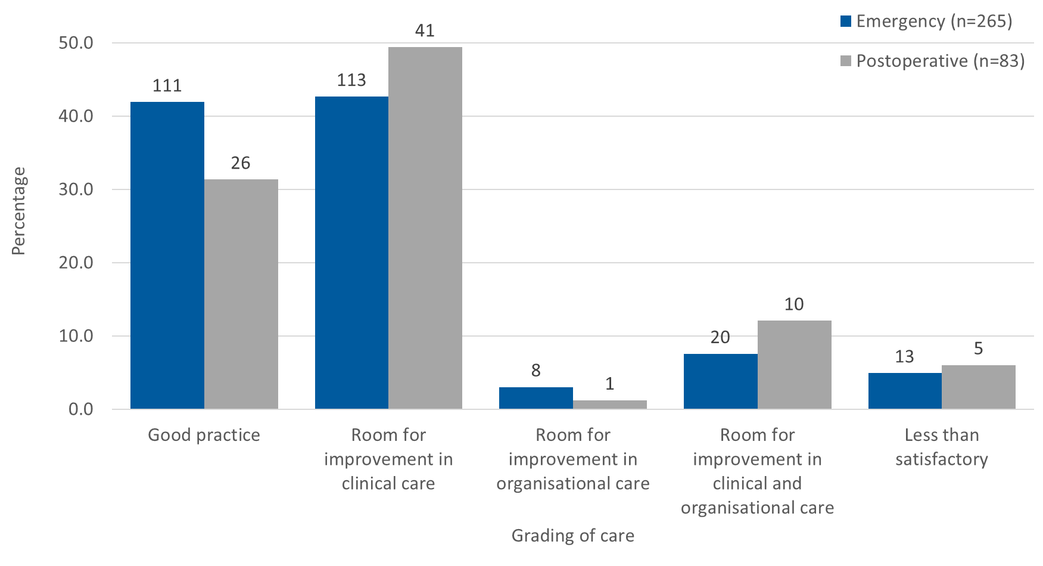
Overall quality of rehabilitation care
Notes:
The quality-of-care grading by the reviewers for emergency admission and postoperative hyponatraemia is shown in the above figure. For both groups of patients, the main areas for improvement related to clinical issues rather than organisational issues (emergency admission: 133/265; 50.2% and postoperative: 51/83; 61.4%)

Slide 6
KEY MESSAGES

Slide 7

1
Develop care bundles and training to reduce variation in the assessment
and management of abnormal blood sodium levels.
Abnormal blood sodium levels were not always acted on as they should have been, leading to under investigation, inappropriate treatments and poor overall management.
The data showed that 163/348 (46.8%) of patients with hyponatraemia should have had further investigations.
Serum and urine osmolality results were available in 50% of patients within 3.5 hours and 9 hours respectively.
Only 25/150 (16.7%) patients had cortisol samples collected between 8:00 am and 9:00 am.
Training on hyponatraemia was better provided to foundation doctors (84.3%) compared to other grades of doctors (37.0%).
Training on hypernatraemia was only provided in 14/99 (14.1%) hospitals.

Slide 8
2
Improve the clinical assessment of fluid status in all patients.
Patients do not have consistent assessment of their fluid status and monitoring and/or recording of their fluid balance
57/248 (23.0%) patients with hyponatraemia did not have an initial fluid status assessment documented.
Point-of-care ultrasound (PoCUS) was only used in three patients to assist in the initial fluid status assessment.
Monitoring and documentation of fluid balance was inadequate in 99/267 (37.1%) patients.
The accuracy of completion of fluid balance charts was only audited in 51/83 (61.4%) hospitals.

Slide 9
3
Integrate test results into patient electronic records to help identify trends in blood sodium levels.
Frequently, results from point-of-care testing are not directly linked into the hospital laboratory electronic reporting system leading to delays in treatment.
There were delays in the initial treatment of patients with emergency admission hyponatraemia (64/255; 25.1%).
Data showed 92.5% (357/386) of initial hyponatraemia results were done by laboratory testing rather than POC.
Point-of-care (POC) testing results are typically available more rapidly than formal laboratory testing results.

Slide 10
4
Standardise the use and the dosing of hypertonic saline solution
Clinical staff are unsure when to use hypertonic saline and the dosage needed. This is hindered further by the variability in the concentrations stocked across all hospitals
55/354 (15.5%) patients received hypertonic saline as part of their treatment. For seven, this was not indicated.
There was variability in the strength of hypertonic saline use (38 patients got 2.7%, 12 got 1.8% and 2 got both).
In 17/55 (30.9%) there were issues related to its use (decision, volume, rate and/or duration of administration).
A further 19 should have hypertonic saline treatment.

Slide 11
5
Document and communicate all medication changes to all healthcare
providers and patients
Medication changes were not always communicated which could lead to patients restarting medications that had caused their abnormal blood sodium.
225/270 (83.3%) patients admitted on an emergency basis with hyponatraemia were taking one or more medication that could have contributed to their hyponatraemia.
157 (69.8%) had one or more of their medicines changed during the admission to hospital.
140/151 (92.7%) had some form of communication of these changes to the GP at the time of discharge
Most commonly this was omission from the discharge letter.

Slide 12
RECOMMENDATIONS

Slide 13
Reduce variation in the assessment and management of abnormal blood sodium levels.
Implement processes to reduce variation in the assessment and management of abnormal blood sodium levels.*
Develop national care bundles.
Develop training for all healthcare professionals to be able to assess and treat patients with abnormal blood sodium levels and recognise when to escalate to specialists.
*Promote existing information on hyponatraemia from the Society for Endocrinology and develop it into the care bundle
For action by: Department of Health and Social Care/NHS England, Welsh NHS, Health Department of Northern Ireland, Government of Jersey
Additional stakeholders: Society for Endocrinology, Royal Colleges of Physicians, Royal College of Emergency Medicine, Royal College of Pathologists, Society for Acute Medicine, Royal College of Surgeons, Association of Surgeons, Royal College of Nursing, Faculty for Intensive Care Medicine, Intensive Care Society, Association for Laboratory Medicine, Royal Pharmaceutical Society, UK Kidney Association
Notes:
RATIONALE FOR THE RECOMMENDATION: The care and outcome of patients with an abnormal blood sodium may be improved through timely and appropriate identification and investigation. While there is guidance from the Society of Endocrinology and others on what investigations to do and how to manage hyponatraemia (low sodium), delays and omissions in the appropriate investigations being undertaken for patients were common in this study. Furthermore, patients admitted with conditions that might cause abnormal blood sodium levels should raise a concern and be investigated.
There are currently no national guidelines for managing hypernatraemia (high sodium).

Slide 14
Standardise the assessment and recording of fluid status in all patients with abnormal blood sodium levels.
Develop clear standards and tools for the assessment and recording of fluid status in all patients with abnormal blood sodium levels including, when appropriate, the use of point-of-care ultrasound.*
*Point-of-care ultrasound is relatively new so should be considered as further research in its use is published and standards are developed
For action by: Department of Health and Social Care/NHS England, Welsh NHS, Health Department of Northern Ireland, Government of Jersey
Additional stakeholders: Royal College of Nursing, Royal Colleges of Physicians, Royal College of Emergency Medicine, Royal College of Pathologists, Society for Acute Medicine, Royal College of Surgeons, Faculty for Intensive Care Medicine, Intensive Care Society, Society for Acute Medicine, Royal College of Radiologists, trusts/health boards, Royal Pharmaceutical Society, UK Kidney Association (clinical),British Society for Echocardiography, Intensive Care Society - Focused Ultrasound in Intensive Care (FUSIC), Consortium for the Accreditation of Sonographic Education and Medical Schools/Universities (training), National Institute for Healthcare Research (NIHR) (research into the use of point-of-care ultrasound)
Notes:
RATIONALE FOR THE RECOMMENDATION: Initial and subsequent clinical assessment of fluid status, along with ongoing monitoring of fluid balance after admission were not undertaken well or documented clearly. These assessments should be part of routine clinical care provided by all relevant healthcare professionals. Failure to do these can impact on the appropriateness of the hyponatraemia and hypernatraemia treatment.
In addition, there is now interest in the use of point-of-care ultrasound (PoCUS) alongside clinical assessment to improve the quality of the fluid status assessment. Currently this is not widely used due to the lack of availability of technology and appropriately trained clinicians and the most appropriate way to use PoCUS has not been agreed amongst specialists.

Slide 15
Integrate point-of-care testing results into patient electronic records.
Integrate point-of-care testing results into patient electronic records.
For action by: Commissioners/integrated care boards with the hospitals in their trusts/health boards
Additional stakeholders: Royal College of Nursing, Royal Colleges of Physicians, Royal College of Emergency Medicine, Royal College of Pathologists, Society for Acute Medicine, Royal College of Surgeons, Faculty for Intensive Care Medicine, Intensive Care Society, Society for Acute Medicine, Royal College of Radiologists, Association for Laboratory Medicine, Electronic Patient Record providers
Notes:
RATIONALE FOR THE RECOMMENDATION: Point-of-care analysis, such as blood gas analysers, can enable clinicians to have an initial blood sodium result more rapidly than laboratory results. This allows faster determination if additional investigations and/or specific treatment of hyponatraemia or hypernatraemia is required. Frequently, results from point-of-care testing are not directly linked into the hospital laboratory electronic reporting system and require clinicians to transcribe or include them in the patient’s medical records. This may not happen, so they are ‘lost’, and therefore are not available for review during the current or subsequent admissions, which would allow trends in blood sodium levels to be determined. It is essential that testing done using point of care analysers is validated and quality controlled to ensure the validity and consistency of the reported results.

Slide 16
Standardise the use of hypertonic saline in the management of hyponatraemia.
Develop a national standard for the use of hypertonic saline in the management of hyponatraemia. This should include:
The indications for its use
The dose, route and location of administration
Monitoring the blood sodium levels, including the rate of correction
Actions to be taken if over-correction occurs
A consensus on the strength of hypertonic saline stocked in hospitals.
For action by: Society for Endocrinology
Additional stakeholders: Royal Colleges of Physicians, Royal College of Emergency Medicine, Society for Acute Medicine, Royal College of Surgeons, Association of Surgeons, Royal College of Nursing, Faculty for Intensive Care Medicine, Intensive Care Society, Royal Pharmaceutical Society
Notes:
RATIONALE FOR THE RECOMMENDATION: Many patients had clinical features of hyponatraemic encephalopathy but only half were administered hypertonic saline, and there were patients with no clinical indication who had it administered. When it was administered, there was variation in the rate, route, strength, and location of administration. Currently there is variability in the strength(s) of hypertonic saline stocked in hospitals, which increases risk as resident doctors rotate between hospitals. Additionally, a fifth of patients administered hypertonic saline had inappropriate subsequent monitoring of their blood sodium levels which increases the risk of too-rapid sodium correction, a risk factor for developing osmotic demyelination syndrome.

Slide 17
Raise awareness of the importance of documenting and communicating all medication changes .
Raise awareness of the importance of documenting and communicating all medication changes made in hospital to primary care as well as the patients and their family/carers.
For action by: Royal Colleges of Physicians, Royal College of Emergency Medicine, Society for Acute Medicine, Royal College of Surgeons, Association of Surgeons, Royal College of Nursing, Faculty for Intensive Care Medicine, Intensive Care Society, Royal College of General Practitioners, Royal Pharmaceutical Society
Additional stakeholders: Commissioners/integrated care boards, Department of Health and Social Care/NHS England, Welsh NHS, Health Department of Northern Ireland, Government of Jersey
Notes:
RATIONALE FOR THE RECOMMENDATION: Most patients reviewed were taking one or more medicine that could be associated with the development of either hyponatraemia or hypernatraemia. Patients should have a thorough medication review (prescribed, over-the-counter and others) at the time an abnormal blood sodium is identified. As a result, many patients had changes to their prescribed medications during the admission to hospital (for example doses changed, switching to alternative medicines, and/or stopping of medication(s)). These changes were not clearly outlined at the point of discharge to the GP, other healthcare professionals involved in their care, patients and/or their family/carers.

Slide 18



Slide 19
REPORT AND TOOLS
www.ncepod.org.uk/2025bs.html
Report
Summary
Infographic
Recommendation checklist
Audit tool
Driver diagram
Fishbone diagram
Commissioners guide

